Slide 1
Chapter 11
Liquids and
Intermolecular Forces

Slide 2
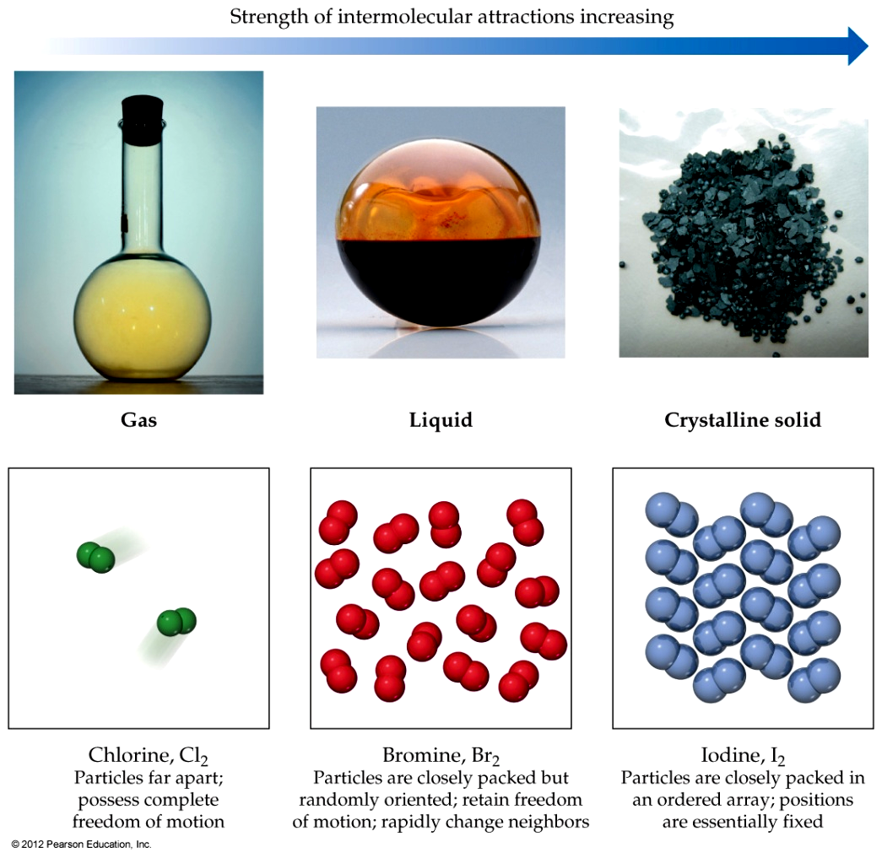
States of Matter
The fundamental difference between states of matter is the distance between particles.

Slide 3
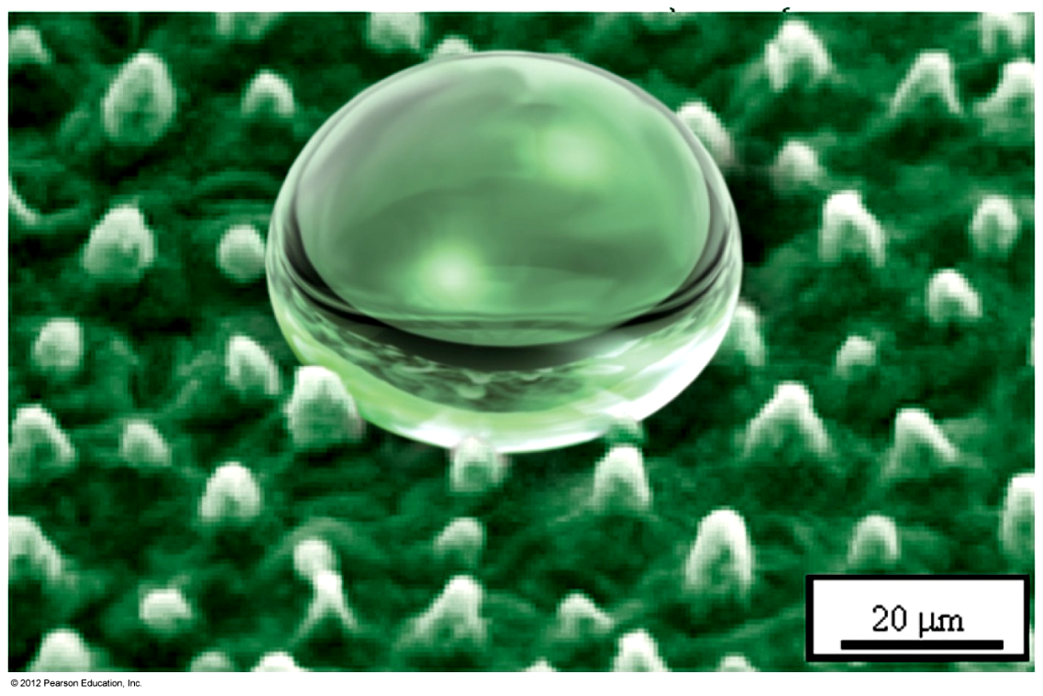
States of Matter
Because in the solid and liquid states particles are closer together, we refer to them as condensed phases.

Slide 4
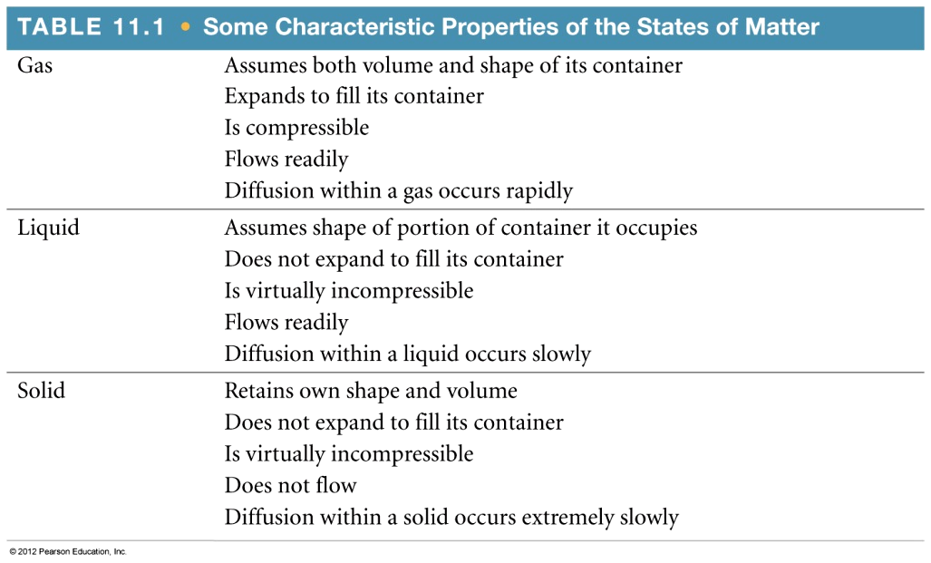
The States of Matter
The state a substance at a particular temperature and pressure depends on two antagonistic entities:
  The kinetic energy of the particles.
  The strength of the attractions between the particles.

Slide 5
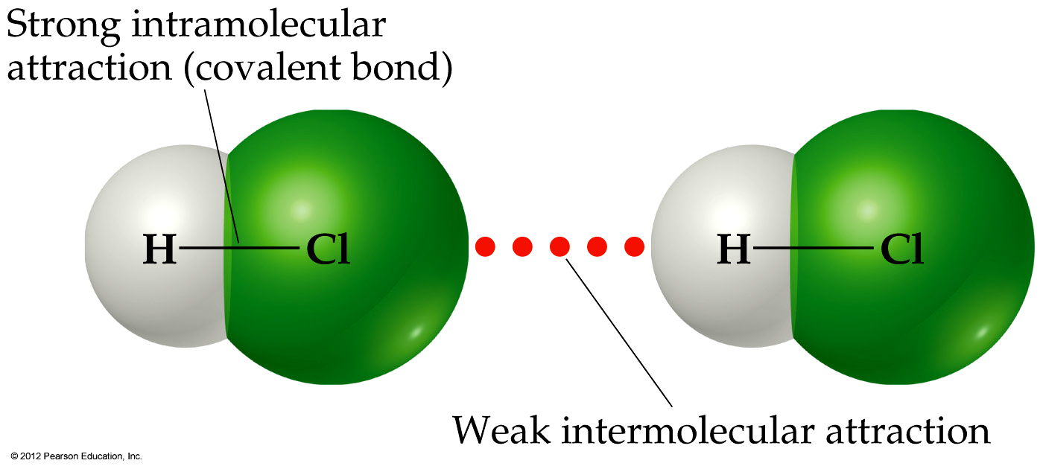
Intermolecular Forces
431 kJ/mol
16 kJ/mol
The attractions between molecules are not nearly as strong as the intramolecular attractions that hold compounds together.

Slide 6
Intermolecular Forces
431 kJ/mol
16 kJ/mol
These intermolecular attractions are, however, strong enough to control physical properties, such as boiling and melting points, vapor pressures, and viscosities.

Slide 7
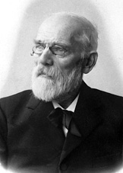
van der Waals Forces (between neutral molecules)
Dipole–dipole interactions
Hydrogen bonding
Dipole – induced dipole
interactions
London dispersion forces
(instantaneous dipole-induced dipole)
Johannes Diderik van der Waals
1837−1923

Slide 8
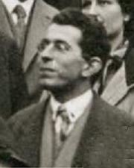
London Dispersion Forces
Fritz Wolfgang London
(1900–1954)

Slide 9
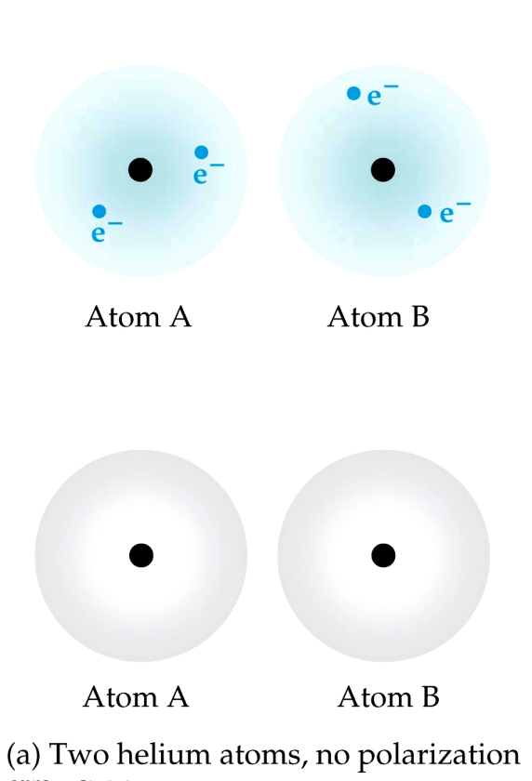
London Dispersion Forces
While the electrons in the 1s orbital of helium would repel each other (and, therefore, tend to stay far away from each other), it does happen that they occasionally wind up on the same side of the atom.

Slide 10
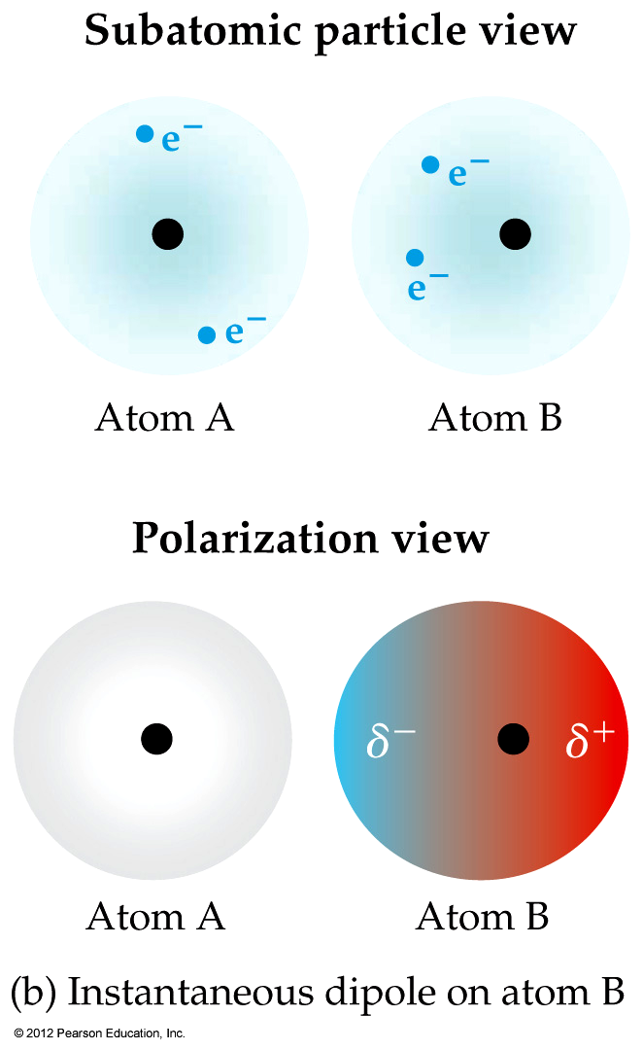
London Dispersion Forces
At that instant, then, the helium atom is polar, with an excess of electrons on the left side and a shortage on the right side.

Slide 11
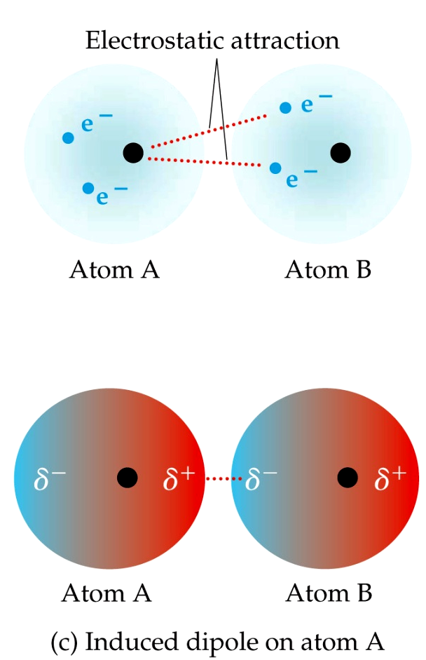
London Dispersion Forces
Another helium atom nearby, then, would have a dipole induced in it, as the electrons on the left side of helium atom 2 repel the electrons in the cloud on helium atom 1.

Slide 12
London Dispersion Forces
London dispersion forces, or dispersion forces, are attractions between an instantaneous dipole and an induced dipole.

Slide 13
London Dispersion Forces
These forces are present in all molecules, whether they are polar or nonpolar.
The tendency of an electron cloud to distort in this way is called polarizability.

Slide 14
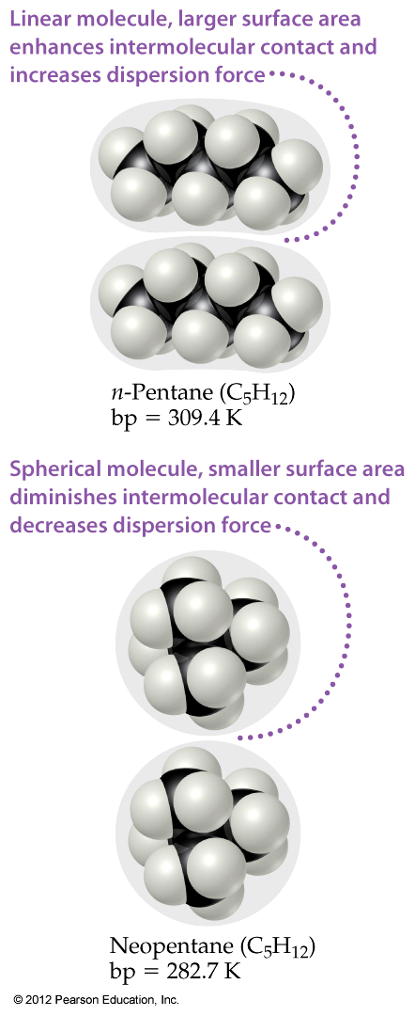
Factors Affecting London Forces
The shape of the molecule affects the strength of dispersion forces: long, skinny molecules (like n-pentane) tend to have stronger dispersion forces than short, fat ones (like neopentane).
This is due to the increased surface area in n-pentane.

Slide 15
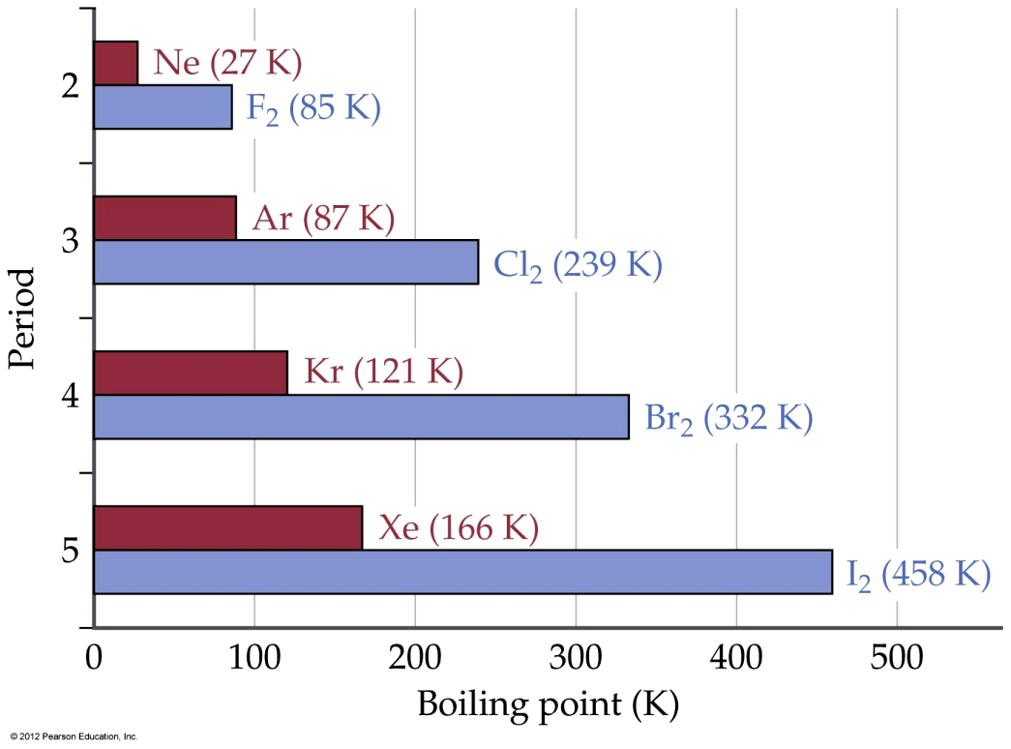
Factors Affecting London Forces
The strength of dispersion forces tends to increase with increased molecular weight.
Larger atoms have larger electron clouds that are easier to polarize.

Slide 16
A. CH₄ < CBr₄ < CCl₄
B. CCl₄ < CH₄ < CBr₄
C. CH₄ < CCl₄ < CBr₄
D. CBr₄ < CCl₄ < CH₄

Slide 17
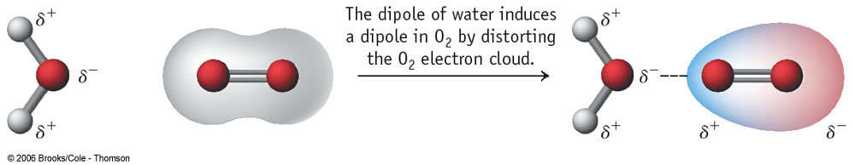
Dipole – Induced Dipole Interactions
A weak attraction that results when a polar molecule induces a dipole in an atom or in a nonpolar molecule by disturbing the arrangement of electrons in the nonpolar species.
Oxygen dissolves in water:
The dipole of water induces a dipole in O₂ by distorting the O₂ electron cloud.

Slide 18
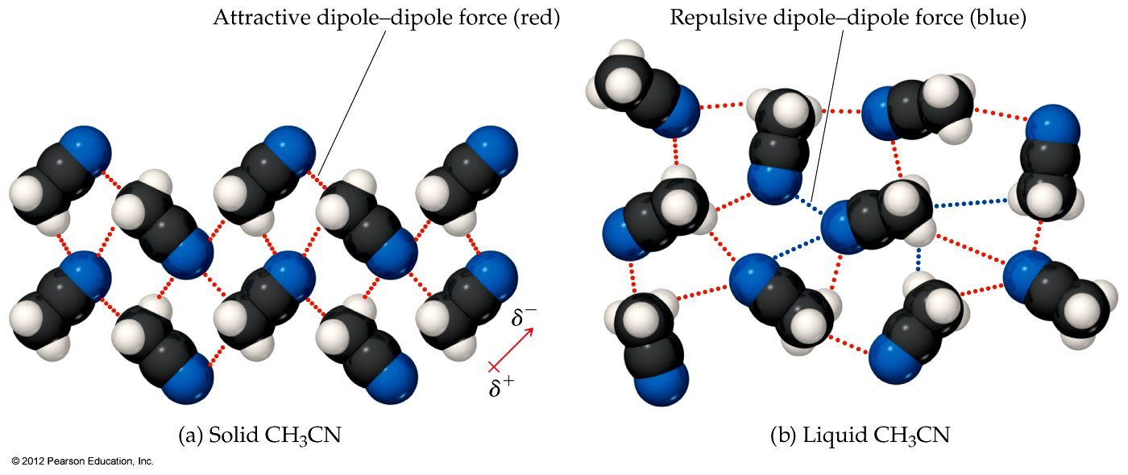
Dipole–Dipole Interactions
Molecules that have permanent dipoles are attracted to each other.
  The positive end of one is attracted to the negative end of the other, and vice versa.
  These forces are only important when the molecules are close to each other.

Slide 19
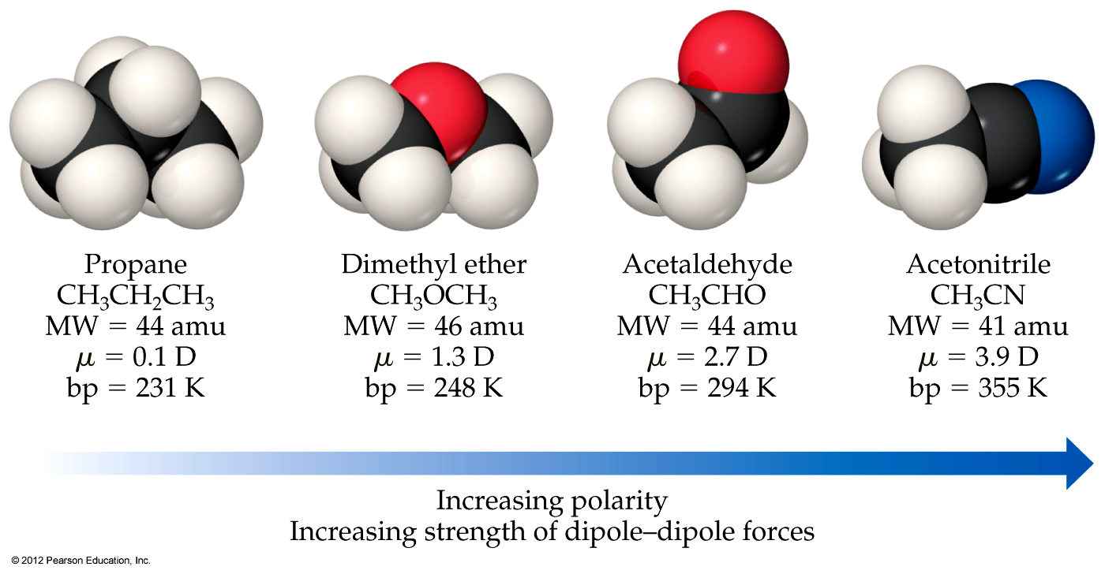
Dipole–Dipole Interactions
The more polar the molecule, the higher its boiling point.

Slide 20
Which Have a Greater Effect?
Dipole–Dipole Interactions or Dispersion Forces
If two molecules are of comparable size and shape, dipole–dipole interactions will likely be the dominating force.
If one molecule is much larger than another, dispersion forces will likely determine its physical properties.

Slide 21
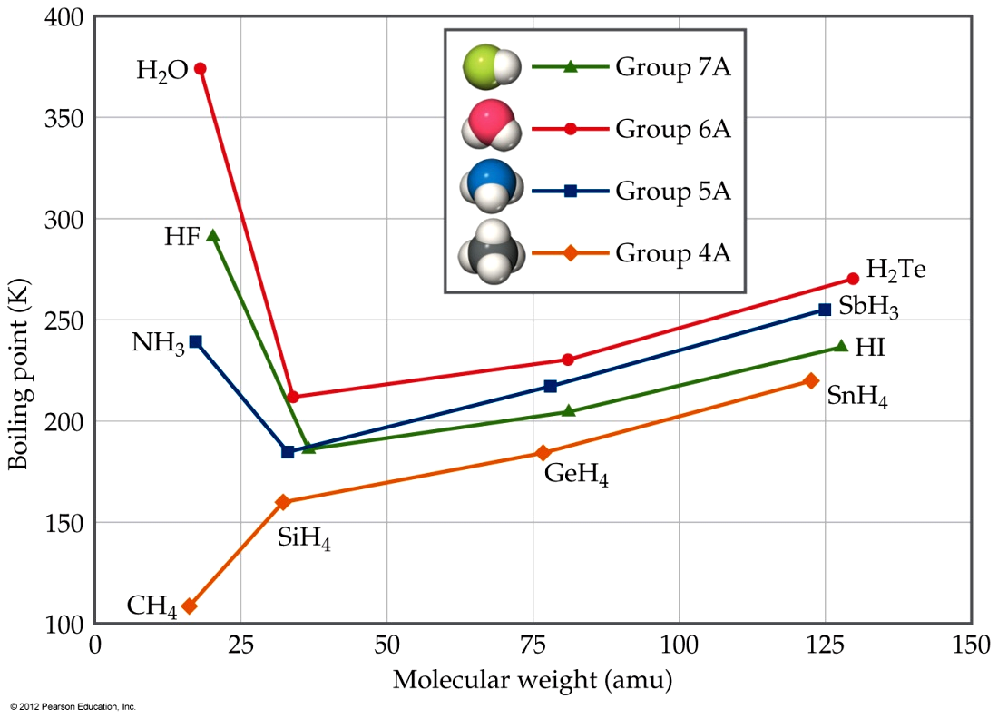
How Do We Explain This?
The nonpolar series (SnH₄ to CH₄) follow the expected trend.
The polar series follow the trend until you get to the smallest molecules in each group.

Slide 22
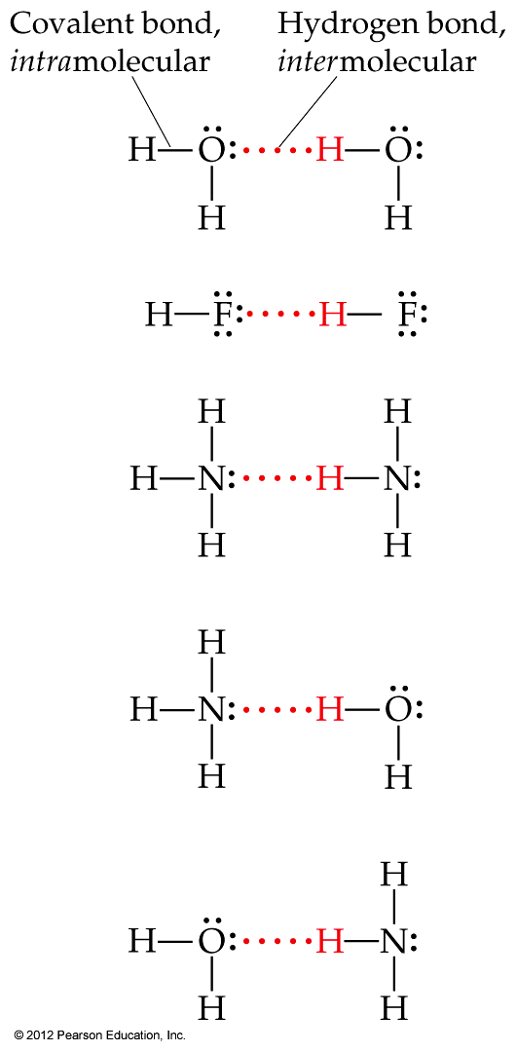
Hydrogen Bonding
The dipole–dipole interactions experienced when H is bonded to N, O, or F are unusually strong.
We call these interactions hydrogen bonds.

Slide 23
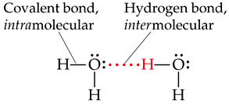
To form a hydrogen bond what must the non-hydrogen atom (N, O, or F) involved in the bond possess?
A. The non-hydrogen atom must have a nonbonding electron pair.
B. The non-hydrogen atom must have low electronegativity.
C. The non-hydrogen atom must have a large atomic size.
D. The non-hydrogen atom must have a small electron affinity.
Lone pair

Slide 24
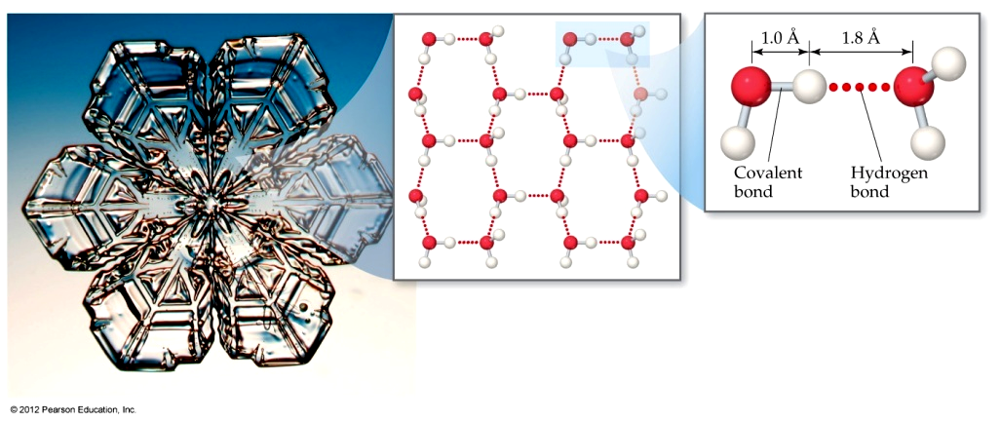
Hydrogen Bonding
Hydrogen bonding arises in part from the high electronegativity of nitrogen, oxygen, and fluorine.
Also, when hydrogen is bonded to one of those very electronegative elements, the hydrogen nucleus is exposed.

Slide 25
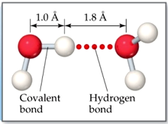
What is the approximate H—O••••H bond angle in ice, where H—O is the covalent bond and O••••H is the hydrogen bond?
A. Approximately 90°
B. Approximately 109°
C. Approximately 120°
D. Approximately 180°

Slide 26
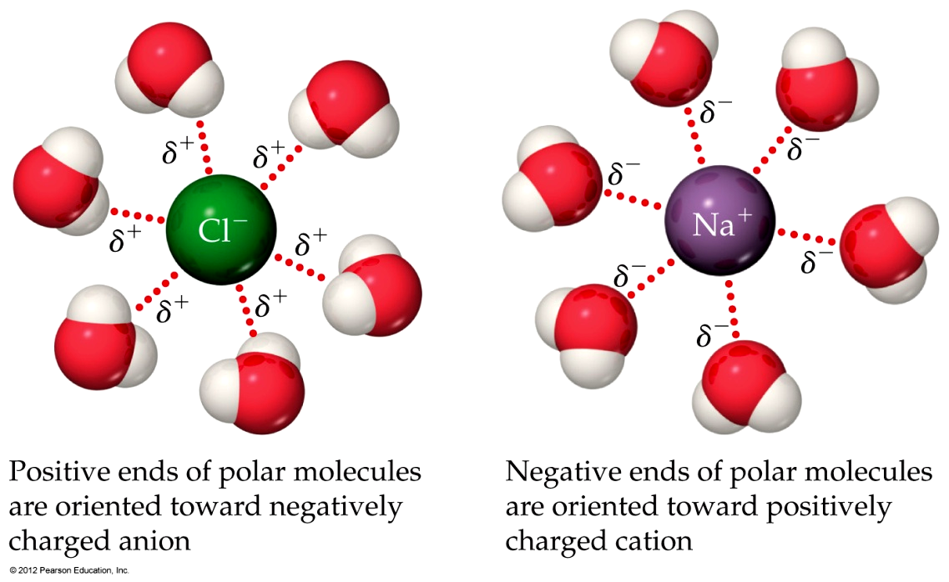
Ion–Dipole Interactions
Ion–dipole interactions (a fourth type of force) are important in solutions of ions.
The strength of these forces is what makes it possible for ionic substances to dissolve in polar solvents.

Slide 27
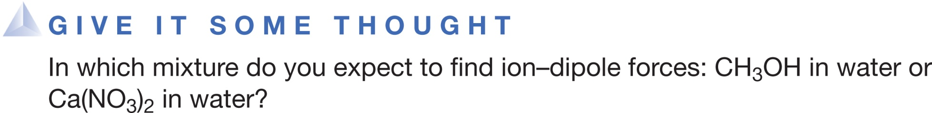
CH₃OH in water, because CH₃OH is a strong electrolyte and forms ions.
Ca(NO₃)₂ in water, because Ca(NO₃)₂ is a strong electrolyte and forms ions.
CH₃OH in water, because CH₃OH is a weak electrolyte and forms ions.
Ca(NO₃)₂ in water, because Ca(NO₃)₂ is a weak electrolyte and forms ions.

Slide 28
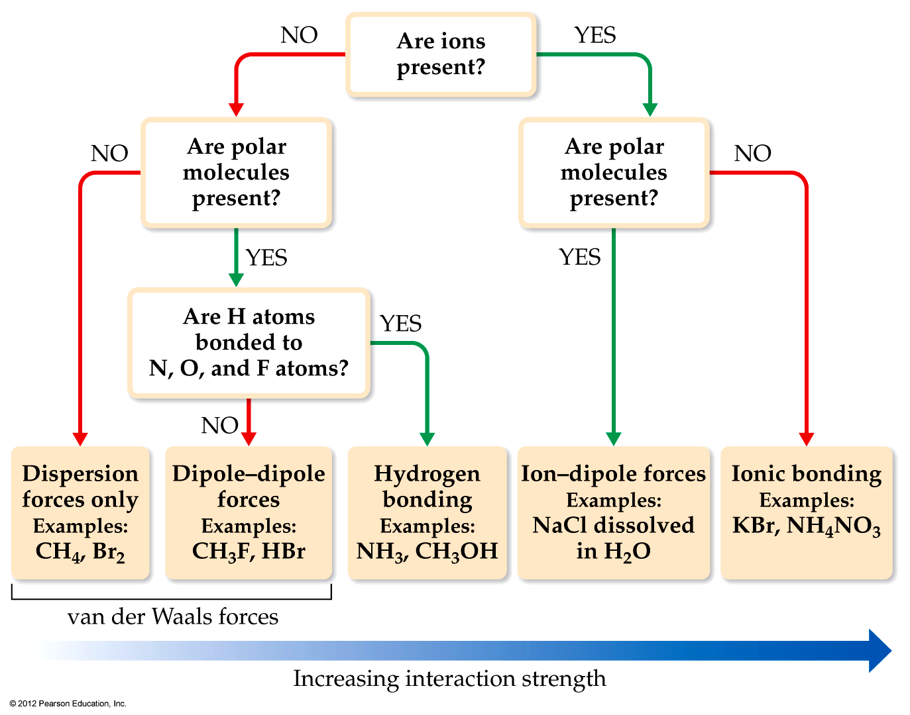
Summarizing Intermolecular Forces

Slide 29
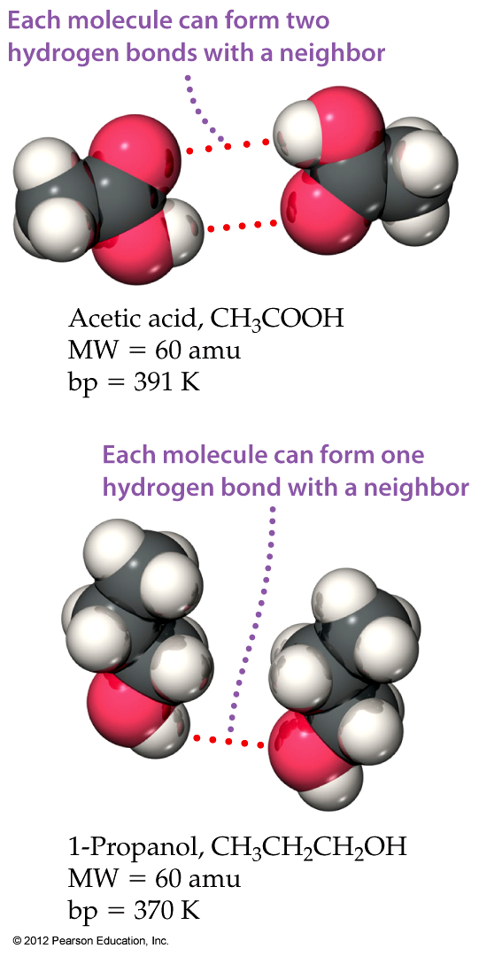
Intermolecular Forces Affect
Many Physical Properties
The strength of the attractions between particles can greatly affect the properties of a substance or solution.

Slide 30
Exercise Predicting Types and Relative Strengths of Intermolecular Attractions
List the substances BaCl₂, H₂, CO, HF, and Ne in order of increasing boiling point.
Solution
Plan The boiling point depends in part on the attractive forces in each substance. We need to order these according to the relative strengths of the different kinds of intermolecular attractions.
Solve The attractive forces are stronger for ionic substances than for molecular ones, so BaCl₂ should have the highest boiling point. The intermolecular forces of the remaining substances depend on molecular weight, polarity, and hydrogen bonding. The molecular weights are H₂ (2), CO (28), HF (20), and Ne (20). The boiling point of H₂ should be the lowest because it is nonpolar and has the lowest molecular weight. The molecular weights of CO, HF, and Ne are similar. Because HF can hydrogen bond, however, it should have the highest boiling point of the three. Next is CO, which is slightly polar and has the highest molecular weight. Finally, Ne, which is nonpolar, should have the lowest boiling point of these three. The predicted order of boiling points is, therefore,
H₂ < Ne < CO < HF < BaCl₂
Check The boiling points reported in the literature are H₂ (20 K), Ne (27 K), CO (83 K), HF (293 K), and BaCl₂ (1813 K)—in agreement with our predictions.

Slide 31
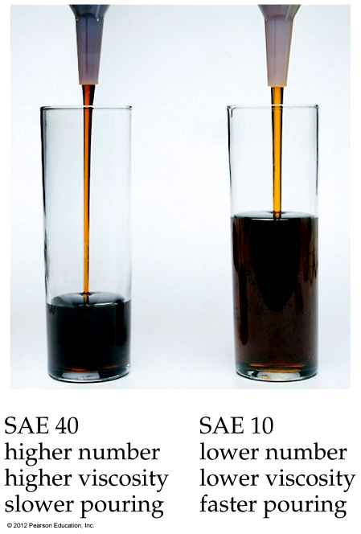
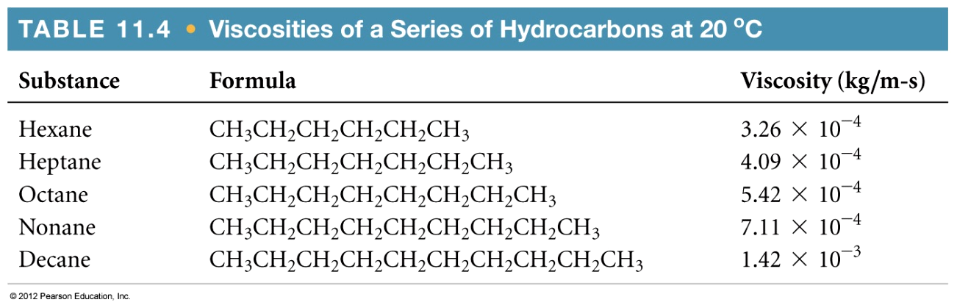
Viscosity
Resistance of a liquid to flow is called viscosity.
It is related to the ease with which molecules can move past each other.
Viscosity increases with stronger intermolecular forces and decreases with higher temperature.

Slide 32
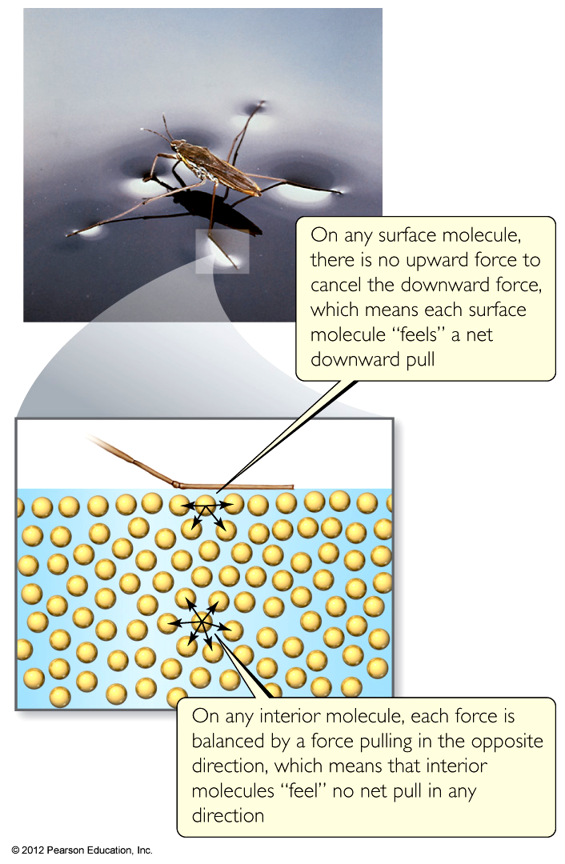
Surface Tension
Surface tension results from the net inward force experienced by the molecules on the surface of a liquid.
It is the energy required to increase area of a liquid by a unit amount (J/m²)

Slide 33
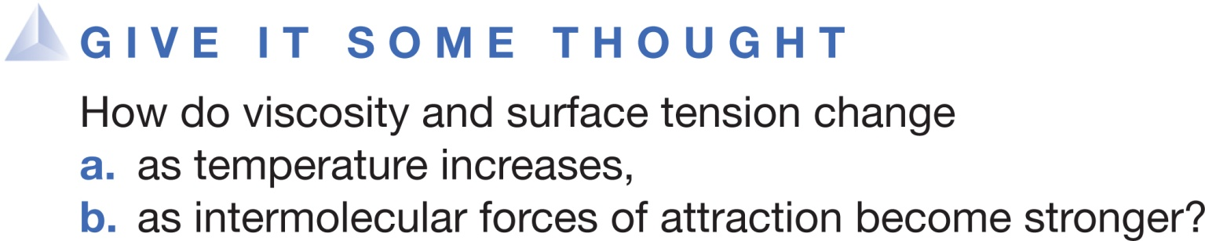
A. Viscosity increases as intermolecular forces increase while surface tension decreases. Both viscosity and surface tension increase with increasing temperature.
B. Viscosity decreases as intermolecular forces increase while surface tension increases. Both viscosity and surface tension increase with decreasing temperature
C. Both viscosity and surface tension increase as intermolecular forces increase and temperature decreases.
D. Both viscosity and surface tension decrease as intermolecular forces increase and temperature increases.

Slide 34
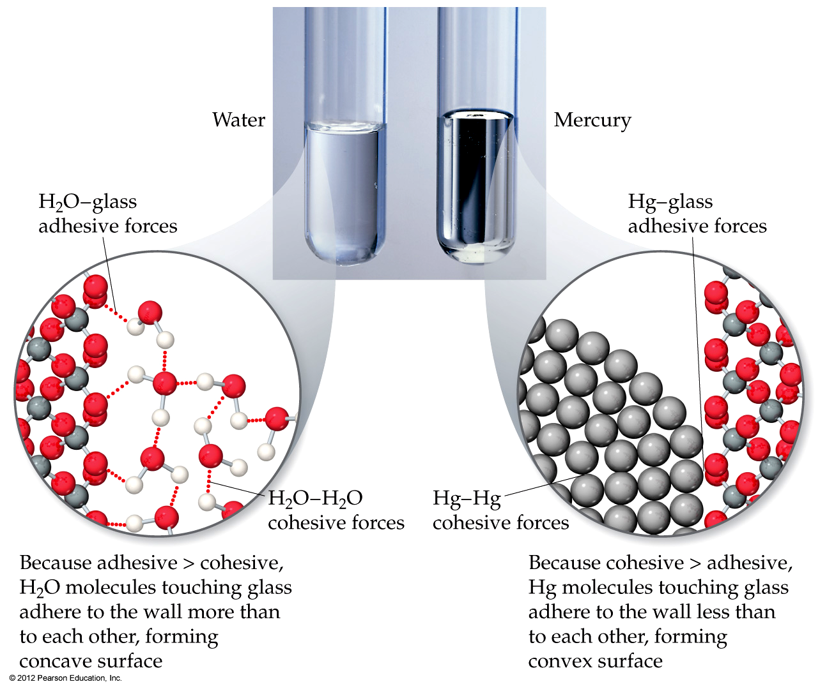
Wetting and Non-Wetting
surface/substance

Slide 35
If the inside surface of each tube were coated with wax, would the general shape of the water meniscus change? Would the general shape of the mercury meniscus change?
Shape of Water Meniscus Shape of Hg Meniscus
A. Yes, Inverted U Yes, downward U
B. No change Yes, downward U
C. No change No change
D. Yes, Inverted U No change

Slide 36
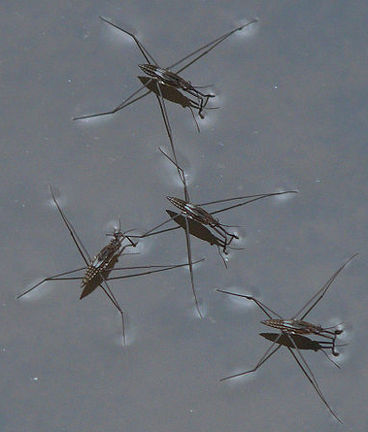

Water-Repellent Legs of Water Striders
Water striders (Gerris remigis) have remarkable non-wetting legs that enable them to stand effortlessly and move quickly on water, a feature believed to be due to a surface-tension effect caused by secreted wax.

Slide 37
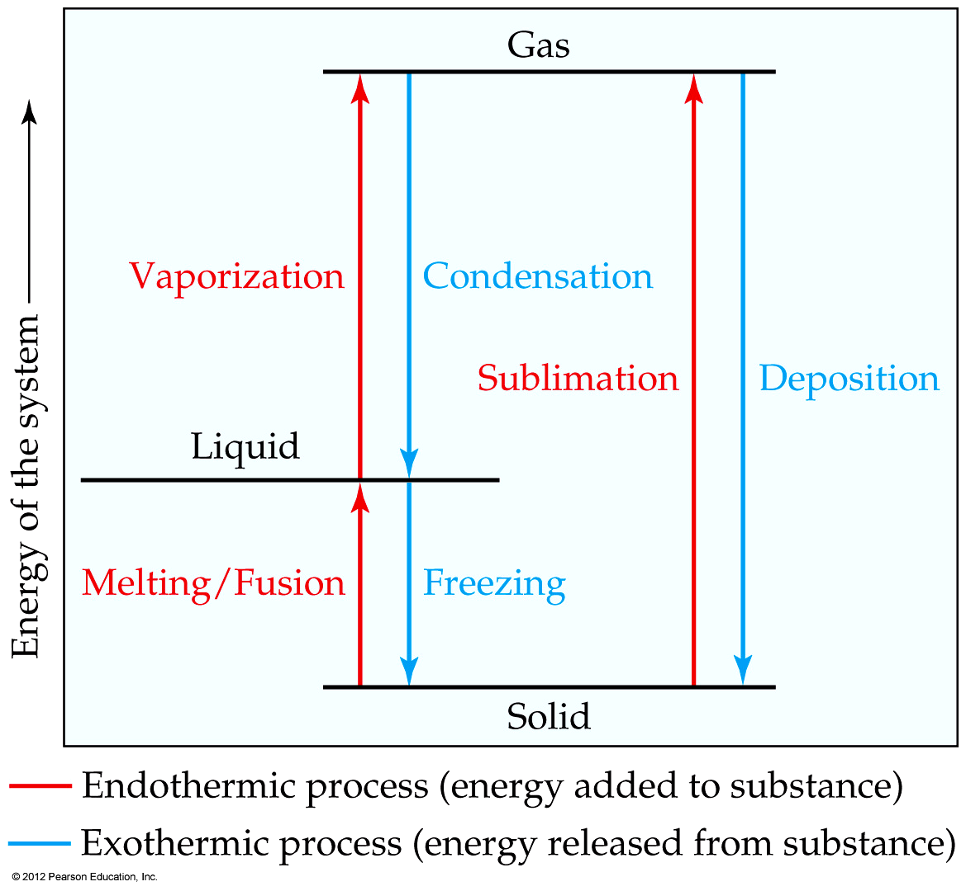
Phase Changes
Notes:
Start here 6/21/10

Slide 38
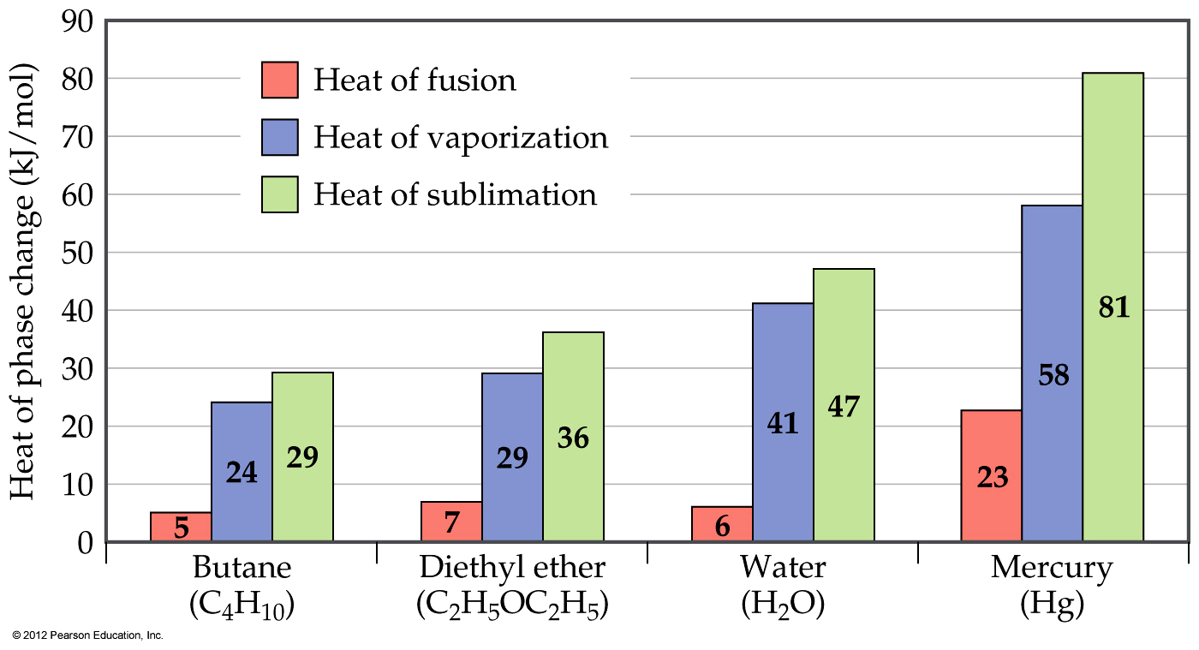
Energy Changes Associated with
Changes of State
The heat of fusion is the energy required to change a solid at its melting point to a liquid.

Slide 39
Energy Changes Associated with
Changes of State
The heat of vaporization is defined as the energy required to change a liquid at its boiling point to a gas.

Slide 40
Energy Changes Associated with
Changes of State
The heat of sublimation is defined as the energy required to change a solid directly to a gas.

Slide 41
Is it possible to calculate the heat of sublimation for a substance given its heats of vaporization and fusion? If so, what is the relationship?
A. No, because we are not dealing with state functions.
B. No, because we need heat of melting.
C. Yes, ΔH_{sub} = ΔH_{fus} + ΔH_{vap}
D. Yes, ΔH_{sub} = ΔH_{fus} – ΔH_{vap}

Slide 42
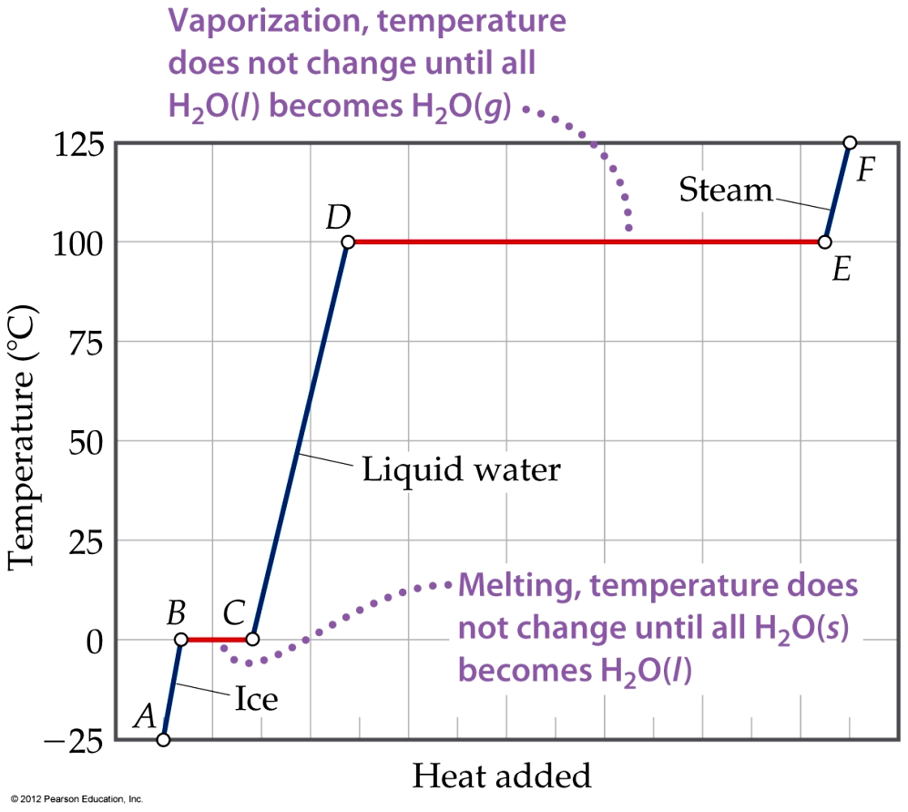
Energy Changes Associated with
Changes of State
The heat added to the system at the melting and boiling points goes into pulling the molecules farther apart from each other.
The temperature of the substance does not rise during a phase change.

Slide 43
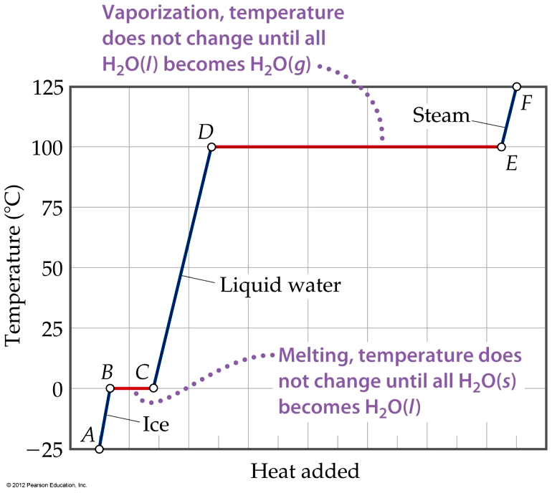
Exercise Calculating ΔH for Temperature and Phase Changes
Calculate the enthalpy change upon converting 1.00 mol of ice at −25 °C to steam at 125 °C under a constant pressure of 1 atm. The specific heats of ice, liquid water, and steam are 2.03 J/g-K, 4.18 J/g-K, and 1.84 J/g-K, respectively. For H₂O, ΔH_{fus} = 6.01 kJ/mol and ΔH_{vap} = 40.67 kJ/mol.
Solution
Plan We can calculate the enthalpy change for each segment and then sum them to get the total enthalpy change (Hess’s law, Section 5.6).
Solve For segment AB in Figure 11.22, we are adding
enough heat to ice to increase its temperature by
25 °C. A temperature change of 25 °C is the same as a
temperature change of 25 K, so we can use the specific
heat of ice to calculate the enthalpy change during this
process:
AB: ΔH = (1.00 mol)(18.0 g/mol)(2.03 J/g-K)(25 K) = 914 J = 0.91 kJ

Slide 44
Exercise Calculating ΔH for Temperature and Phase Changes (continued)
For segment BC in Figure 11.22, in which we convert ice to water at 0 °C, we can use the molar enthalpy of fusion directly:
The enthalpy changes for segments CD, DE, and EF can be calculated in similar fashion:
The total enthalpy change is the sum of the changes of the individual steps:
BC: ΔH = (1.00 mol)(6.01 kJ/mol) = 6.01 kJ
CD: ΔH = (1.00 mol)(18.0 g/mol)(4.18 J/g-K)(100 K) = 7520 J = 7.52 kJ
DE: ΔH = (1.00 mol)(40.67 kJ/mol) = 40.7 kJ
EF: ΔH = (1.00 mol)(18.0 g/mol)(1.84 J/g-K)(25 K) = 830 J = 0.83 kJ
ΔH = 0.91 kJ + 6.01 kJ + 7.52 kJ + 40.7 kJ + 0.83 kJ = 56.0 kJ

Slide 45
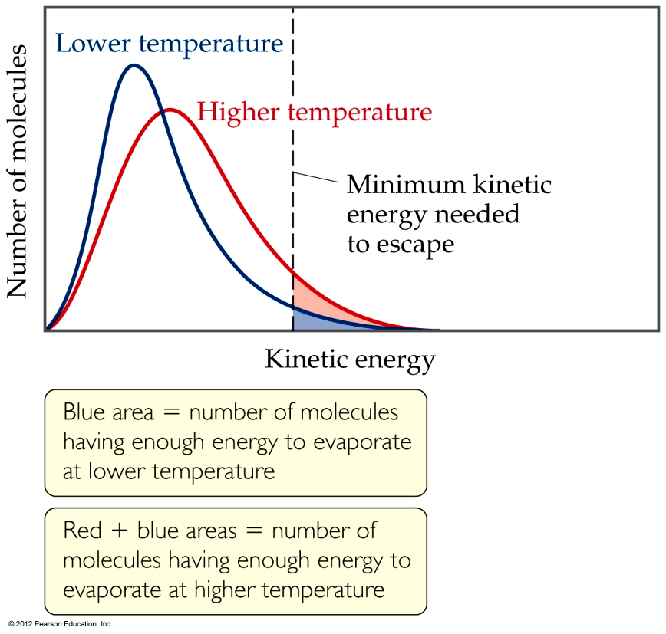
Vapor Pressure
At any temperature some molecules in a liquid have enough energy to break free.
As the temperature rises, the fraction of molecules that have enough energy to break free increases.

Slide 46
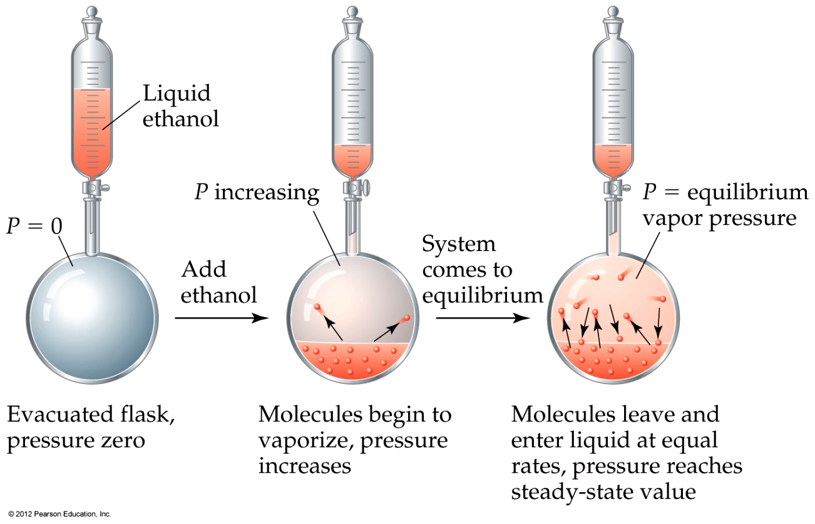
Vapor Pressure
As more molecules escape the liquid, the pressure they exert increases.

Slide 47
Vapor Pressure
The liquid and vapor reach a state of dynamic equilibrium: liquid molecules evaporate and vapor molecules condense at the same rate.

Slide 48
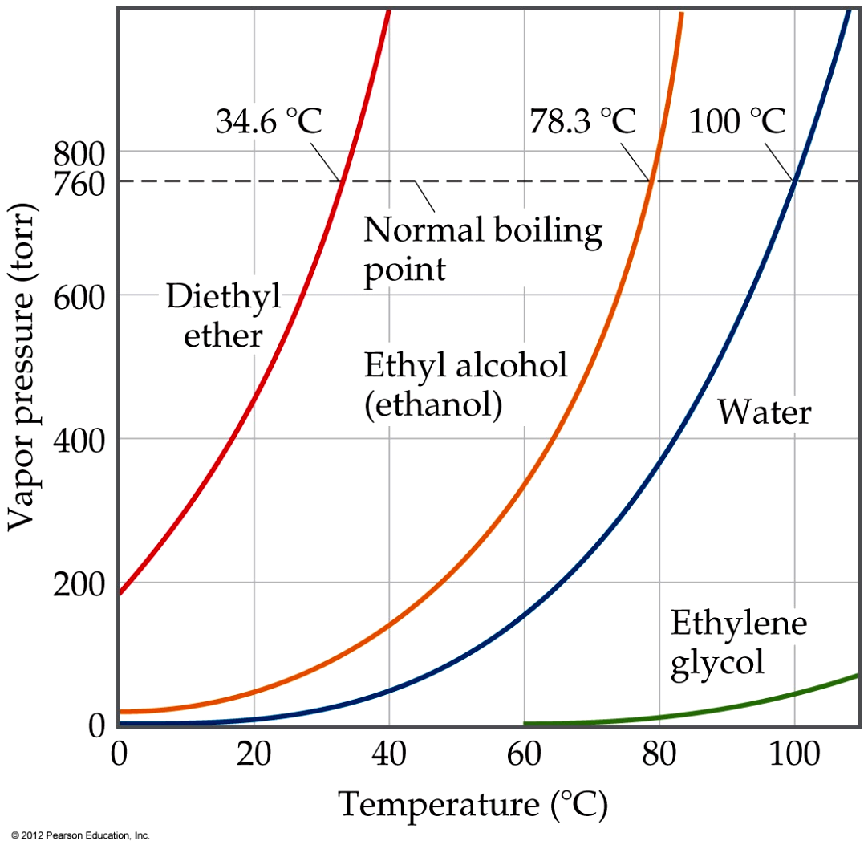
Vapor Pressure
The boiling point of a liquid is the temperature at which its vapor pressure equals atmospheric pressure.
The normal boiling point is the temperature at which its vapor pressure is 760 torr.

Slide 49
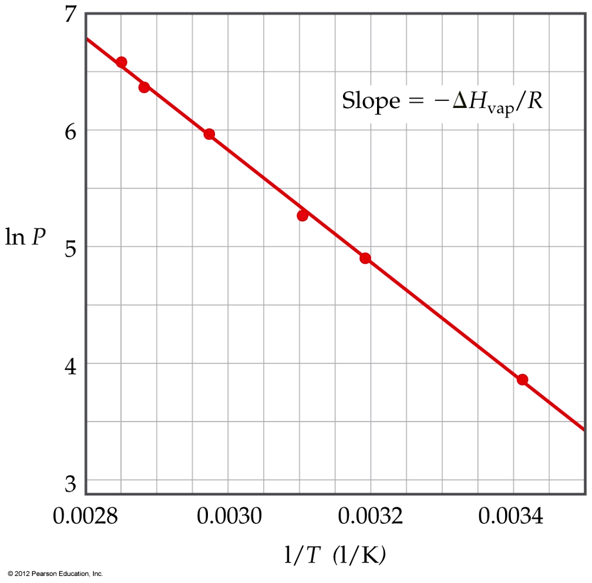
Vapor Pressure
The natural log of the vapor pressure of a liquid is inversely proportional to its temperature.

Slide 50
Vapor Pressure
This relationship is quantified in the Clausius–Clapeyron equation:
ln P = −ΔH_{vap}/RT + C,
where C is a constant.

Slide 51
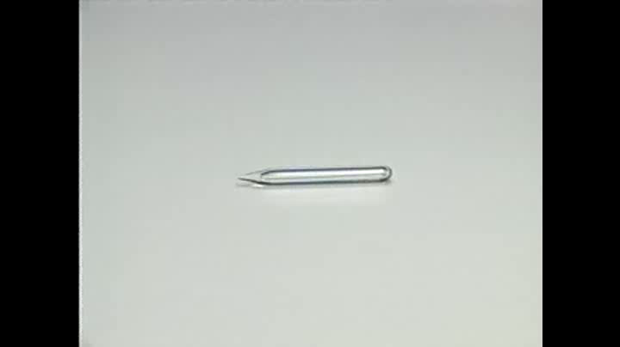
Critical Point of Benzene

Slide 52
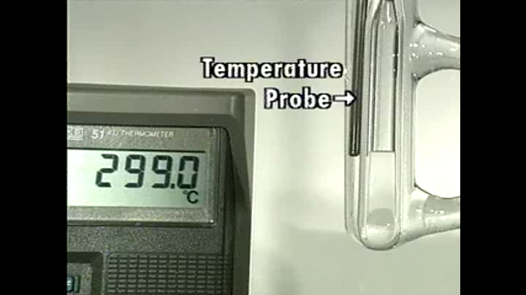
Critical Point of Benzene

Slide 53
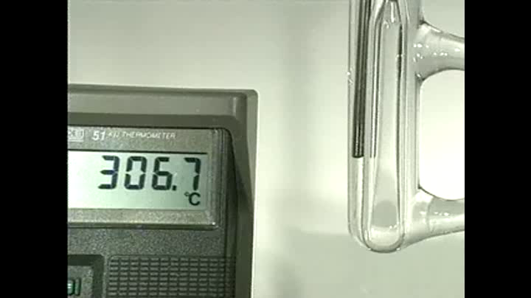
Critical Point of Benzene

Slide 54
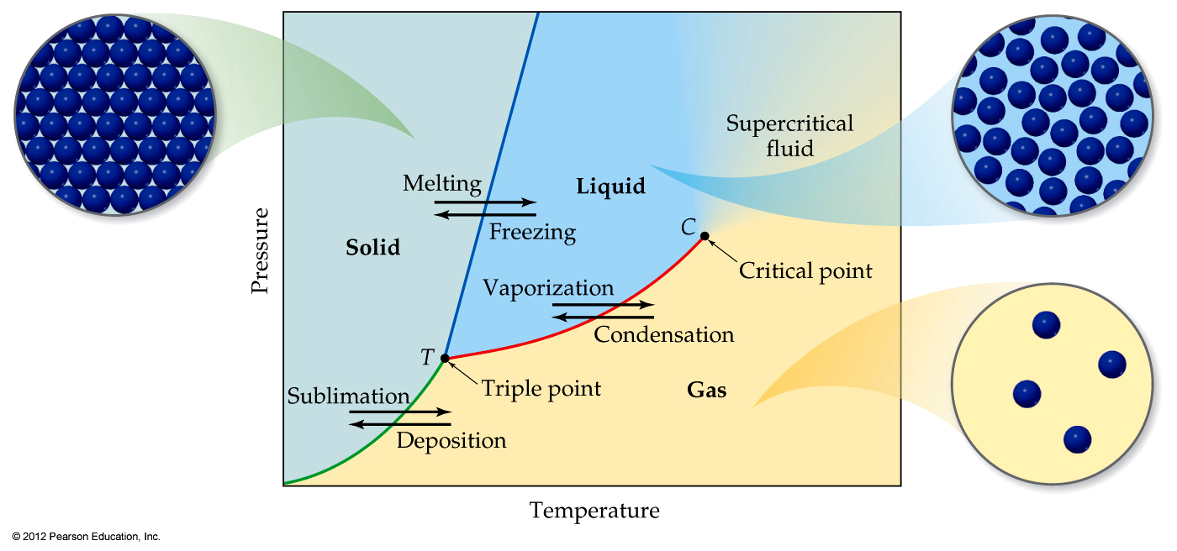
Phase Diagrams
Phase diagrams display the state of a substance at various pressures and temperatures, and the places where equilibria exist between phases.

Slide 55
Phase Diagrams
The liquid–vapor interface starts at the triple point (T), at which all three states are in equilibrium, and ends at the critical point (C), above which the liquid and vapor are indistinguishable from each other.

Slide 56
Phase Diagrams
Each point along this line is the boiling point of the substance at that pressure.

Slide 57
Phase Diagrams
The interface between liquid and solid marks the melting point of a substance at each pressure.

Slide 58
Phase Diagrams
Below the triple point the substance cannot exist in the liquid state.
Along the solid–gas line those two phases are in equilibrium; the sublimation point at each pressure is along this line.

Slide 59
If the pressure exerted on a liquid is increased, while the temperature is held constant, what type of phase transition will eventually occur?
A. Freezing
B. Melting
C. Vaporization
D. Condensation

Slide 60
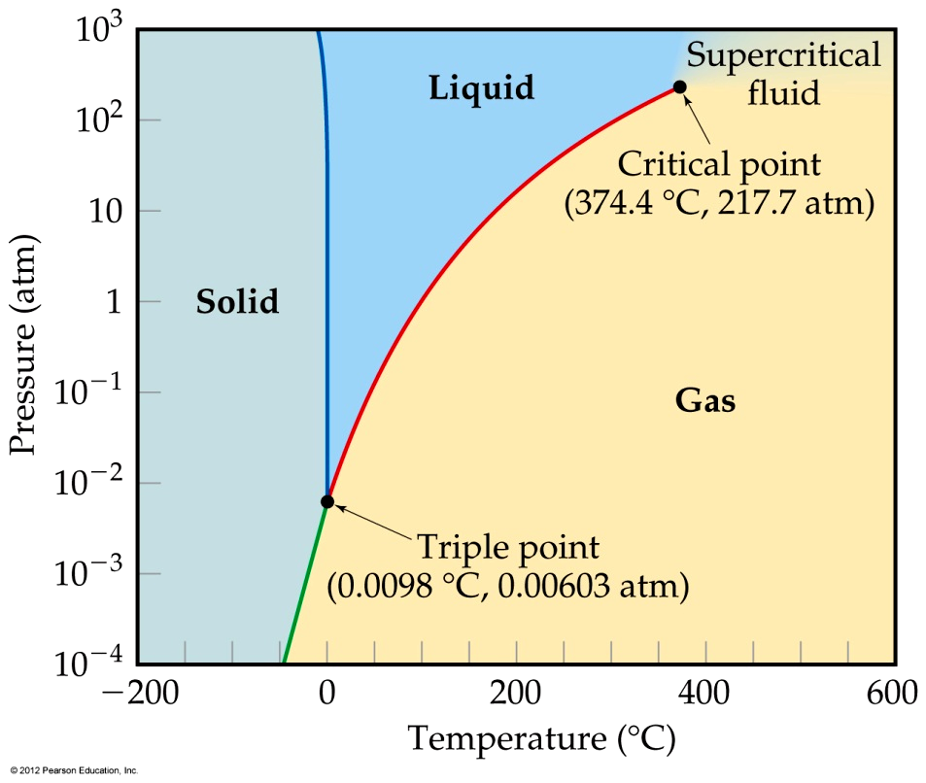
Phase Diagram of Water
Note the high critical temperature and critical pressure.
  These are due to the strong van der Waals forces between water molecules.

Slide 61
Phase Diagram of Water
The slope of the solid–
liquid line is negative.
  This means that as the pressure is increased at a temperature just below the melting point, water goes from a solid to a liquid.

Slide 62
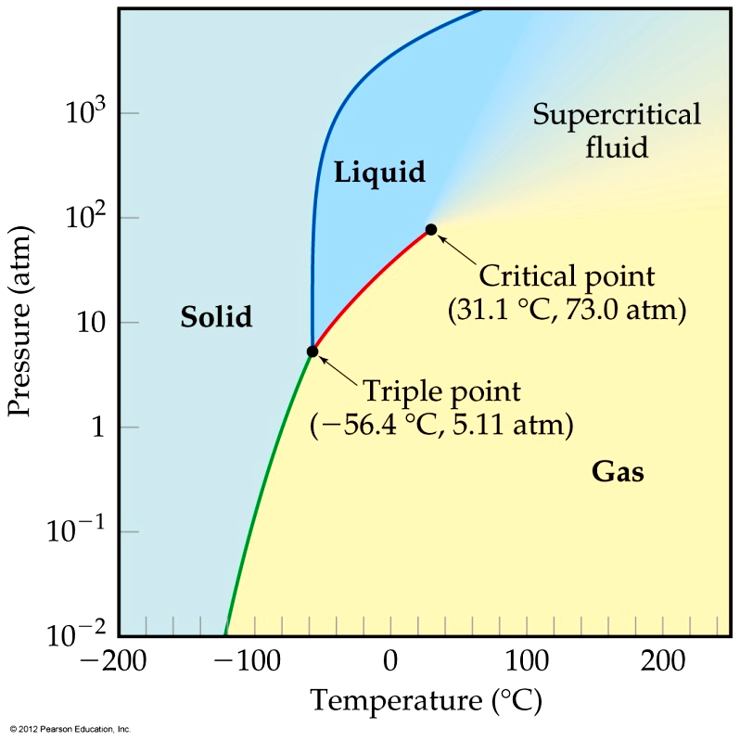
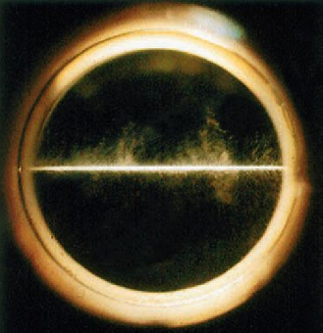
Phase Diagram of Carbon Dioxide
Carbon dioxide cannot exist in the liquid state at pressures below 5.11 atm; CO₂ sublimes at normal pressures.
Supercritical Fluid of CO₂

Slide 63
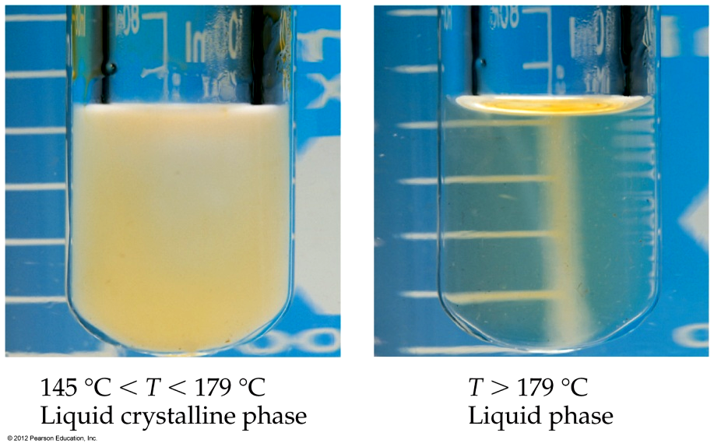
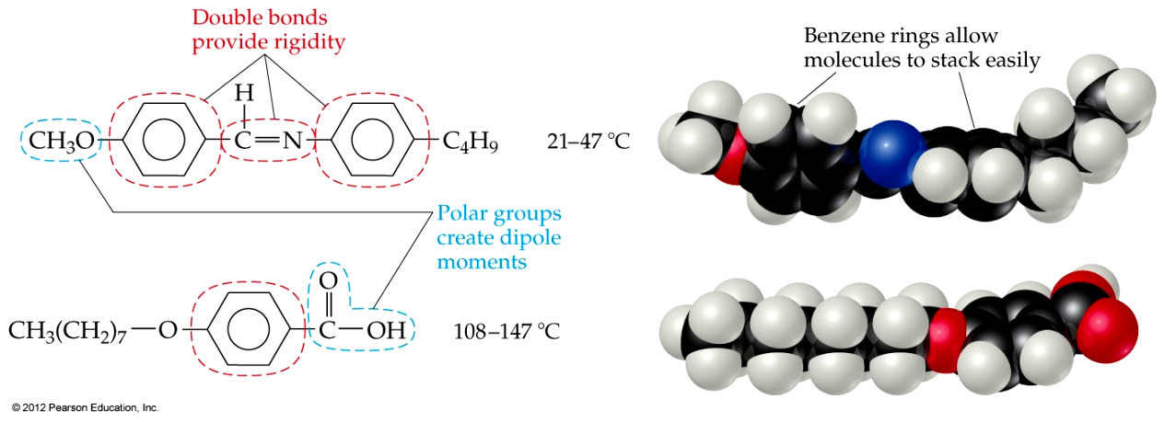
Liquid Crystals
Some substances do not go directly from the solid state to the liquid state.
In this intermediate state, liquid crystals have some traits of solids and some of liquids.

Slide 64
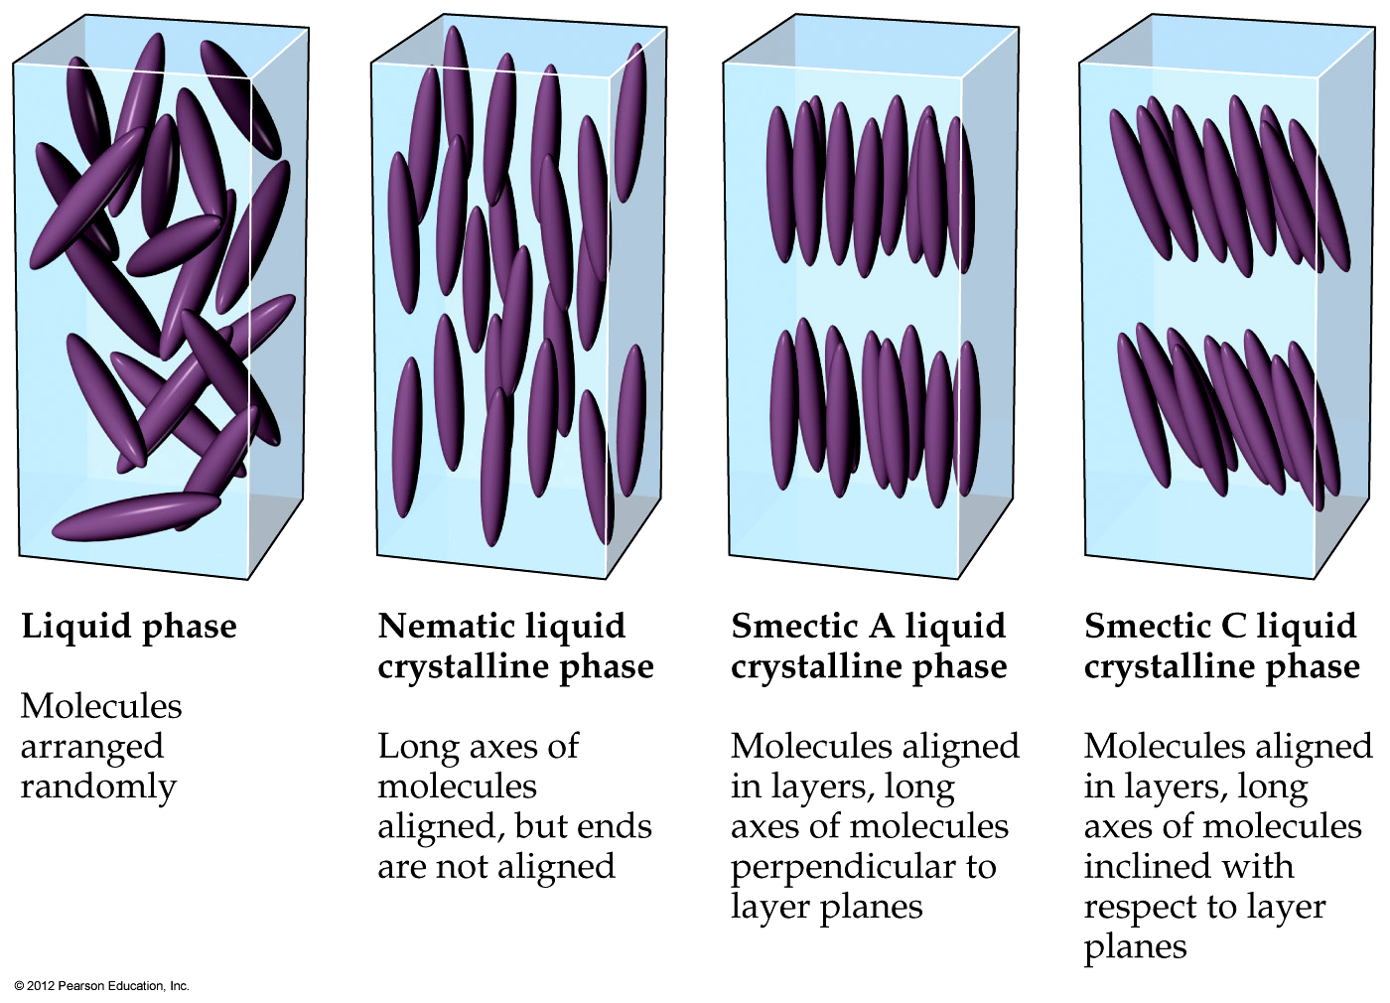
Liquid Crystals
Unlike liquids, molecules in liquid crystals have some degree of order.

Slide 65
Liquid Crystals
In nematic liquid crystals, molecules are only ordered in one dimension, along the long axis.

Slide 66
Liquid Crystals
In smectic liquid crystals, molecules are ordered in two dimensions, along the long axis and in layers.

Slide 67
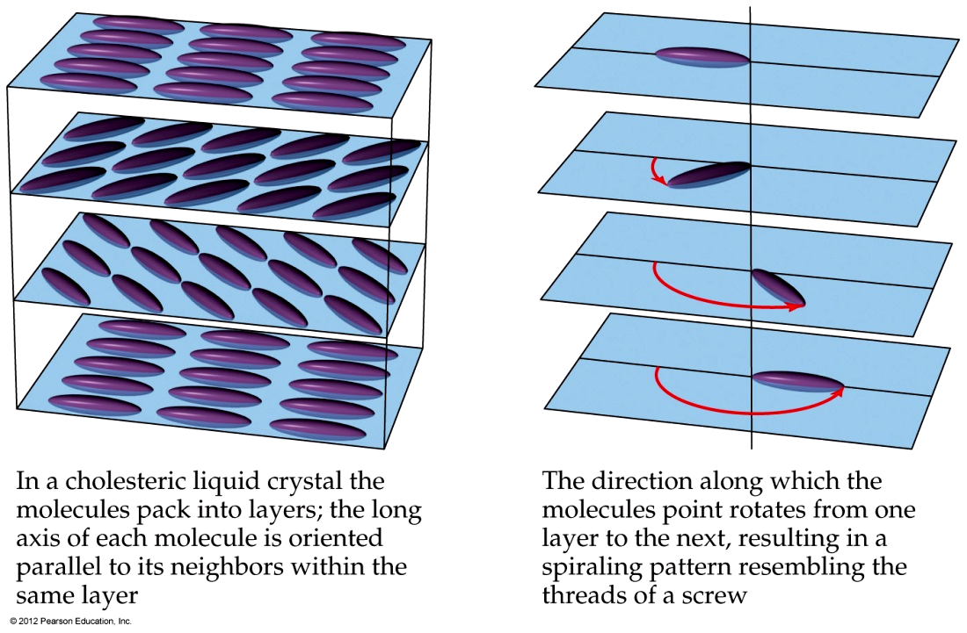
Liquid Crystals
In cholesteryl liquid crystals, nematic-like crystals are layered at angles to each other.

Slide 68

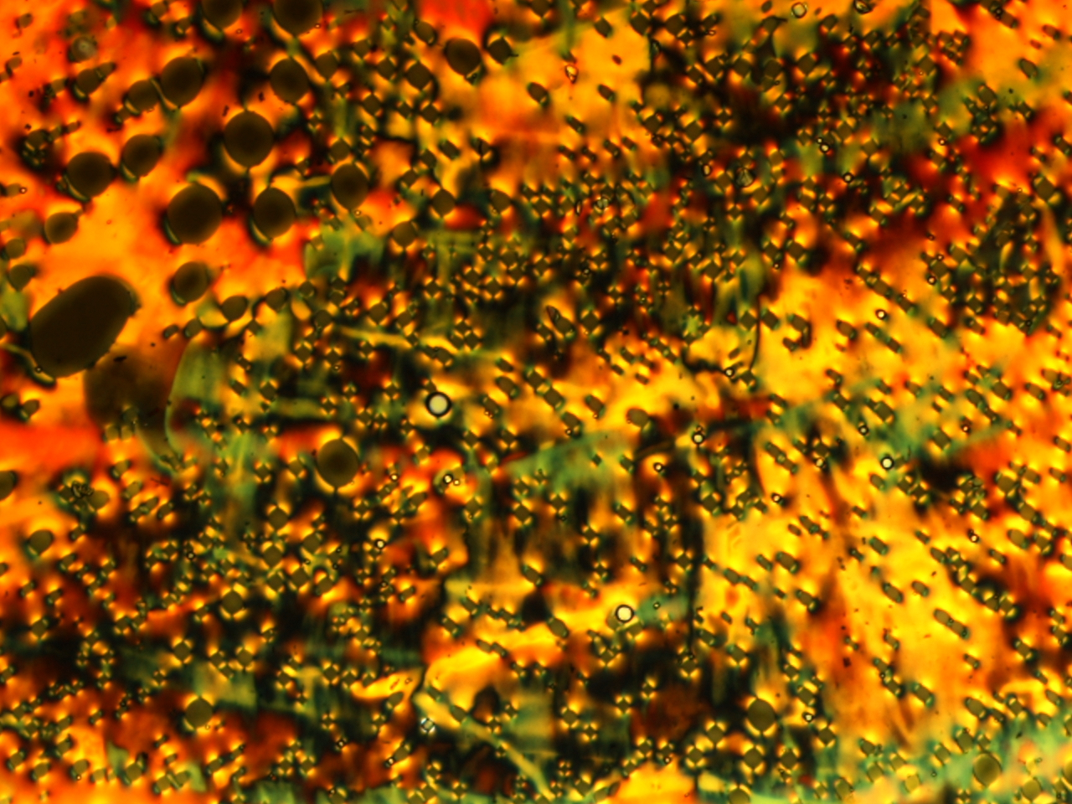
The Beauty of Liquid Crystals

Slide 69
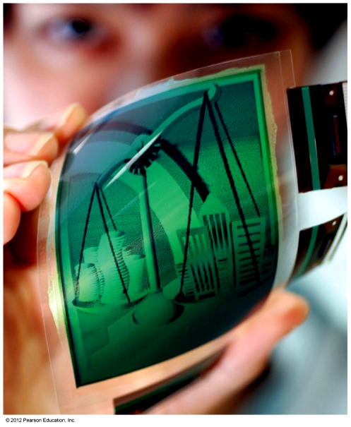

Liquid Crystals
These crystals can exhibit color changes with changes in temperature.

Slide 70

Liquid Crystal Display

Slide 71
Ionic Liquids - Green Solvents for the Future
Salts that are liquid at ambient temperatures.
Low melting organic salts
Very low vapor pressure
Non-flammable
Wide liquid range (300 °C)
Moderate to high viscosity (bad)
Solvent properties different from molecular solvents
Solvent properties can be controlled by selection of anion and cation – hence often termed designer solvents (good).

Slide 72

Ionic Liquids - Green Solvents for the Future
Halide-based (Cl⁻, Br⁻, F⁻)
Halogeno-based (BF₄⁻, PF₆⁻)
Halogenoaluminium(III)
Alkylammonium
Alkylphosphonium
Alkylnitride
N,N’-dialkylimidazolium
N-alkylpyridinium
NO₃⁻, ClO₄⁻,HSO₄⁻ SO₃⁻, CF₃SO₃⁻
(CF₃SO₂)₂N⁻
(CF₃SO₂)₃C⁻
anion
Organic
cation

Slide 73



Ionic Liquids - Green Solvents for the Future

Slide 74

Which force below is the strongest intermolecular attractive force?
Hydrogen bonding
Ion-dipole forces
Dipole-dipole forces
d. London dispersion forces
Notes:
Answer: b

Slide 75
Which force below increases in strength as the molecular weight of the compound increases?
Hydrogen bonding
Ion-dipole forces
Dipole-dipole forces
d. London dispersion forces
Notes:
Answer: d

Slide 76
Which compound below is not capable of forming hydrogen bonds?
CH₄
NH₃
H₂O
d. HF
Notes:
Answer: a

Slide 77
Which compound below has the highest boiling point?
H₂O
H₂S
H₂Se
d. H₂Te
Notes:
Answer: a

Slide 78
Which element below has the highest boiling point?
Kr
F₂
Cl₂
d. Br₂
Notes:
Answer: d

Slide 79
Which substance below has a greater density in its liquid state than in its solid state?
Iron
Glass
Water
d. Carbon dioxide
Notes:
Answer: c

Slide 80
The resistance of a liquid to flow is called the _______ of the liquid.
density
viscosity
potential energy
d. flow rate
Notes:
Answer: b

Slide 81
The energy required to cause a liquid to boil is called the _______ of the liquid.
boiling point
freezing point
heat of vaporization
d. heat of fusion
Notes:
Answer: c

Slide 82
Isopropyl alcohol feels cool to the touch because it has an (X) heat of (Y).
a. X = exothermic, Y = vaporization
X = endothermic, Y = vaporization
X = exothermic, Y = fusion
X = endothermic, Y = fusion
Notes:
Answer: b

Slide 83
When heat is added to ice at zero degrees Celsius, what will happen?
The temperature will increase.
The temperature will decrease.
The temperature will not change.
A supercritical fluid will form.
Notes:
Answer: c

Slide 84
The highest temperature at which a substance can exist in its liquid state is called its _______ point.
boiling
freezing
triple
d. critical
Notes:
Answer: d

Slide 85
The temperature and pressure at which all three phases exist simultaneously is called the _______ point of a substance.
boiling
freezing
triple
d. critical
Notes:
Answer: c

Slide 86
At high altitudes, the boiling point of water is
100 degrees Celsius.
b. greater than 100 degrees Celsius.
less than 100 degrees Celsius.
equal to its freezing point.
Notes:
Answer: c

Slide 87
Substance X has a boiling point of 150 degrees Celsius and a freezing point of 15 degrees Celsius. The condensation point of X
is 150 degrees Celsius.
is 15 degrees Celsius.
is 165 degrees Celsius.
d. is 135 degrees Celsius.
Notes:
Answer: a

Slide 88
Which of the terms below does NOT describe a type of liquid crystal?
Eutectic
Nematic
Smectic
d. Cholesteric
Notes:
Answer: a

